Slide 1
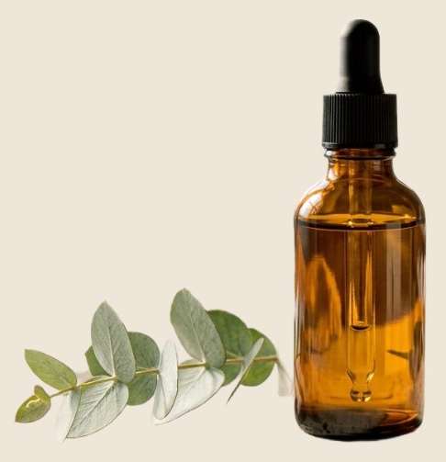
VELORA · LAUNCH PLAN 2026
Glow Serum go-to-
market
Launch the vitamin C serum across DTC, retail partners
and paid social in one coordinated six-week push
Launch date
Target revenue
Channels
Mar 18
$1.2M
4

Slide 2
VELORA.LAUNCHPLAN2026
Channel plan
DTC site
Retail
Paid social
Creators
Product page, bundles and
a 30% launch offer for
subscribers.
48 partner stores with sell
sheets and shelf talkers.
Story and feed creatives,
weekly creative refresh.
20 skincare creators with
seeded kits and codes.
Launch readiness·62%

